Slide 1

Government Accounting Dimension
Marc Joffe, Policy Analyst
April 16, 2024

Slide 2
State and Local Government Accounting
Over 90,000 state and local governments in the US
Of which more than 30,000 require annual audits because:
They issue municipal debt securities
They spend more than $750,000 of federal funds
Are subject to state reporting requirements
Governments use different financial reporting standards than companies
Governmental Accounting Standards as promulgated by GASB are covered at a basic level on the CPA Financial Accounting and Reporting (FAR) exam
They are covered at greater depth in the Business Analysis & Reporting (BAR) exam
02

Slide 3
Industry Comments
[W]e are already seeing a growing shortage of CPAs working in state and local government accounting functions or with CPA firms qualified to perform governmental audits. Inadequately staffed government accounting departments and insufficiently qualified audit firms leads to delays in audits and reporting of required public information. Smaller local governments and regional based firms that serve government clients will likely be the most adversely impacted. Further, it may lead to lower quality work and avoidable audit failures.
- California Society of CPAs
[A]udit quality at SLGs continues to be problematic at both large and small firms, with the profession responding to this problem by establishing the Governmental Audit Quality Center.
- Illinois Auditor General
Source: AICPA, Comments on Proposed Changes to CPA Exam, 2020
03

Slide 4
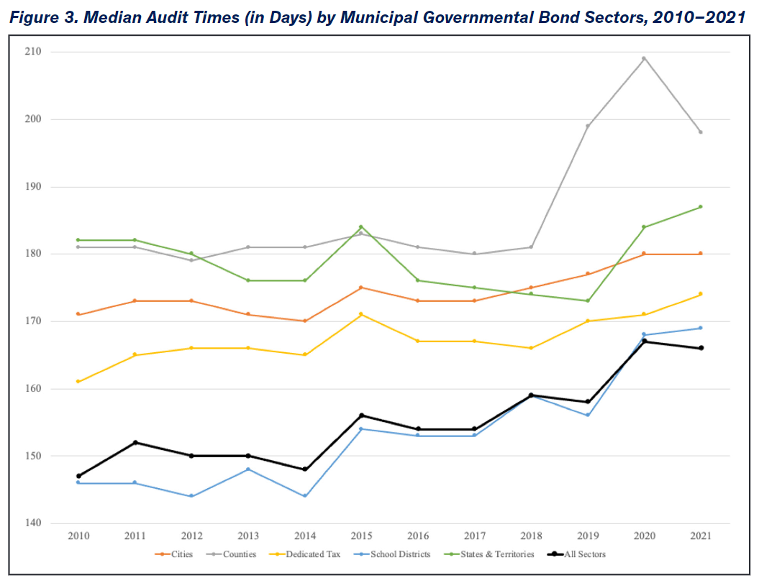
Municipal Audit Lags are High and Increasing
“Staffing shortages and an insufficient number of auditors have recently been cited as the primary reason for slower audit times by public sector auditors”
Source: Merritt Research Services and Government Finance Research Center (UIC)
04

Slide 5
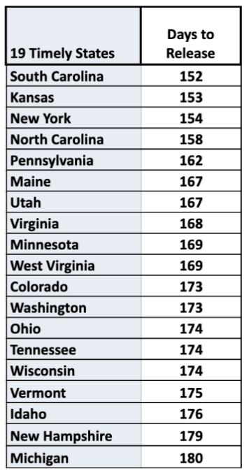
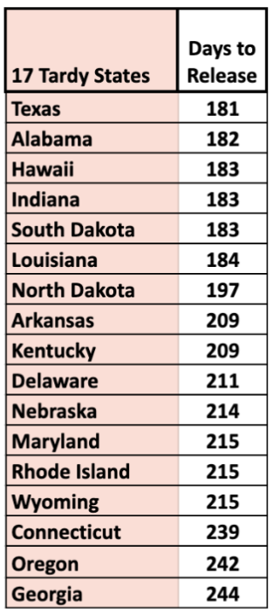
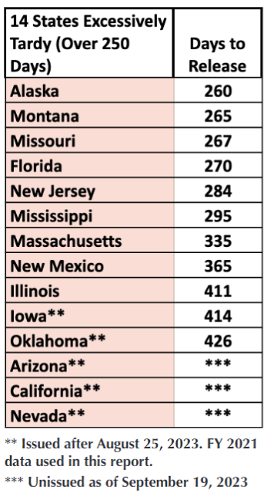
Range of State Audit Lags – FY 2022
Source: Truth in Accounting, Financial State of the States
05

Slide 6
Ultra-Late Government Audits (As of 4/9/2024)
Governmental Entity | Population | Latest Available Audit (Fiscal Year Ending)
Mt. Vernon, NY | 71,714 | 12/31/2016
Chester, PA (in Chapter 9 bankruptcy) | 33,449 | 12/31/2018
Hopewell, VA | 22,962 | 6/30/2019
Stonecrest, GA | 61,087 | 12/31/2019
Compton, CA (also skipped 2014-2017) | 91,988 | 6/30/2020
Columbus, MS | 23,273 | 9/30/2020
Pullwan, WA | 32,508 | 12/31/2020
Cicero, IL | 81,919 | 12/31/2020
Novato, CA | 52,184 | 6/30/2021
Puerto Rico* | 3,205,691 | 6/30/2021
*Update: Puerto Rico’s FY 2022 ACFR was filed on 4/10/24, which is 650 days after FYE.
06

Slide 7
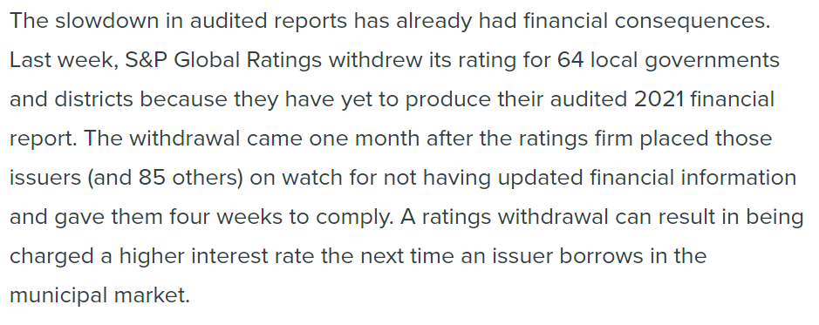
Credit Rating Implications
- Liz Farmer, Route Fifty, April 18, 2023
07

Slide 8
Challenges with Audit Quality
Financial Statement Deficiency | Percentage Displaying Deficiency
The financial statements or notes to financial statements contained mathematical errors (not related to rounding). | 13%
The note on Other Postemployment Benefits did not include a brief description of the types of benefits and the authority under which benefit provisions are established or amended. | 27%
Legal authority of the primary government and each component unit not included. | 10%
Source: Florida Auditor General, Review Of Local Governmental Entity 2021-22 Fiscal Year Audit Reports
08

