Slide 1
Notes on the Budget Outlook and Fiscal Policy
William Gale
Brookings Institution and Tax Policy Center
January 11, 20202

Slide 2
Deficit and Debt Patterns – Past and Future
In the distant past (pre-Reagan)
Deficits caused by defense build-ups during major wars (or by depressions)
Debt/GDP fell after wars because of cuts in defense
The recent buildup has been very different
Debt/GDP = 39% in 2008
Debt/GDP = 70% in 2012 (Financial crises, Recession, Stimulus package)
Debt/GDP = 102% in 2021 (2017 tax cut, COVID, recession, relief, stimulus)
Future deficits
Persistent and rising primary deficits (i.e., not counting interest payments)
Interest rate is key to sustainability

Slide 3
Why do we care about deficits?
Hemingway (The Sun Also Rises)
Character 1: “How did you go bankrupt?”
Character 2: “Two ways. Gradually, then suddenly”
Suddenly: Could U.S. debt cause a financial crisis?
Seems unlikely – we are not Greece.
We can pay our debt for decades to come. We issue debt in our own currency.
2008 example. Japan example.
Caveat: Policymakers could create a politically-induced crisis
Gradually: Debt place burdens on future generations
Crowds out productive capital (“termites in the woodwork”)
Increases debt service payments in the future
This depends on interest rates, though.

Slide 4
But not all debt is bad!
To finance needed wars, major investments in human and physical capital, anti-recession policy
Plus, investors world-wide want US debt for safety and liquidity (–> low r)
We bequeath a lot of things to future generations besides debt
Infrastructure
Environment
Education system
Health system
So, how we spend the money matters, not just the debt

Slide 5
Some key spending facts
Big 4: Social Security, health care, defense, interest
Typically, about 70% of federal spending
In the next 10 years, >100% of the increase in spending/GDP
Social security provides critical support for many households
SS accounts for >50% of income for 40% of elderly HH (>=90% for 14%)
Health spending is concentrated among high-cost episodes and individuals (→ HSA’s not very helpful)
Medicaid and CHIP provide health care to about 45% of U.S. kids
Solid, emerging evidence that investments in kids and low-income workers (EITC) pay economic and fiscal dividends over time

Slide 6
Deficits are not a “spending problem”
An imbalance between taxes and spending
Which side of the scissors does the cutting?
Net interest is the result of prior deficits, not a new spending program
SS, health programs are the playing out of commitments made decades ago, not new spending programs
Politicians chose not to provide the financing needed at that time
Revenues have been cut and are not projected to rise very much

Slide 7
Deficit Reduction is a Classic Political Problem
The benefits accrue later (to many people who don’t have a vote now), the costs would be imposed sooner.
The costs are concentrated, benefits are diffuse (Olson).
The benefits (better economy) are hard to link directly to the policies (building example).
Americans deplore red ink but oppose most of the policies that would fix the problem.
Solution will require bipartisanship (so each side can blame the other).

Slide 8
Thinking about Solutions
We don’t need
To balance the budget permanently – that would imply debt/GDP falling forever
To eliminate debt – very bad idea
A constitutional amendment for balanced budget – unspeakably bad idea
False Solutions
“Cut foreign aid”
Inflation
Tax Cuts
Growth – will help, but not enough
Real Solutions
Entitlement reform
Investing in human and public capital
Raising revenues, restructuring taxes, and redistributing burdens

Slide 9
Tax Options
Raise taxes on the rich
Equity / inequality (close loopholes, offset widening income and wealth distribution)
Efficiency (close loopholes, “tax wealth without creating a wealth tax”)
Within the existing system
Income tax rates and base (capital gains, MID, pass-thru deduction)
Corporate tax rates and base (move to cash flow, raise rates)
Estate tax/inheritance tax
Via new options
Wealth tax (unlikely to work)
Progressive consumption tax (or a VAT with UBI = 2 * poverty rate; every other country has a VAT)
Crack down on evasion
16% of all income and >50% of farm and sole proprietorships income is not reported to IRS
Carbon tax
Giving every coal miner $250k would cost 1% of the 10-year revenue from a carbon tax

Slide 10
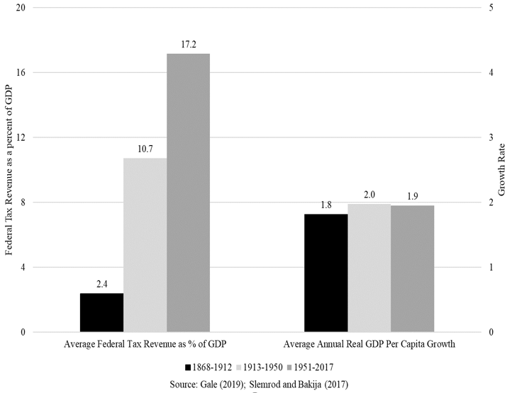
Taxes and Growth: U.S. History

Slide 11
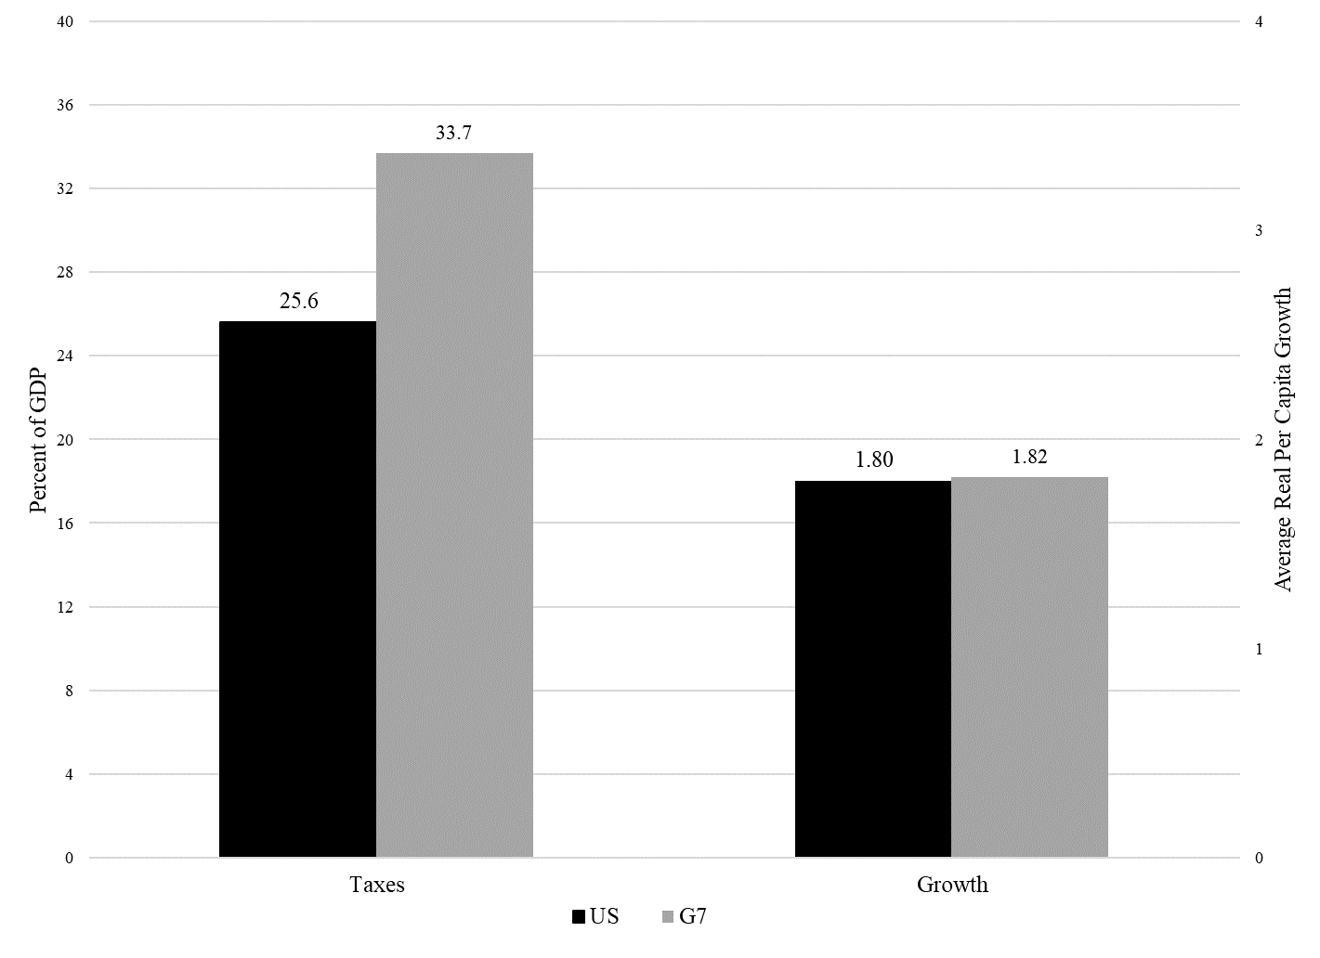
Taxes and Growth: Cross-Country Evidence (1970-2015)

Slide 12
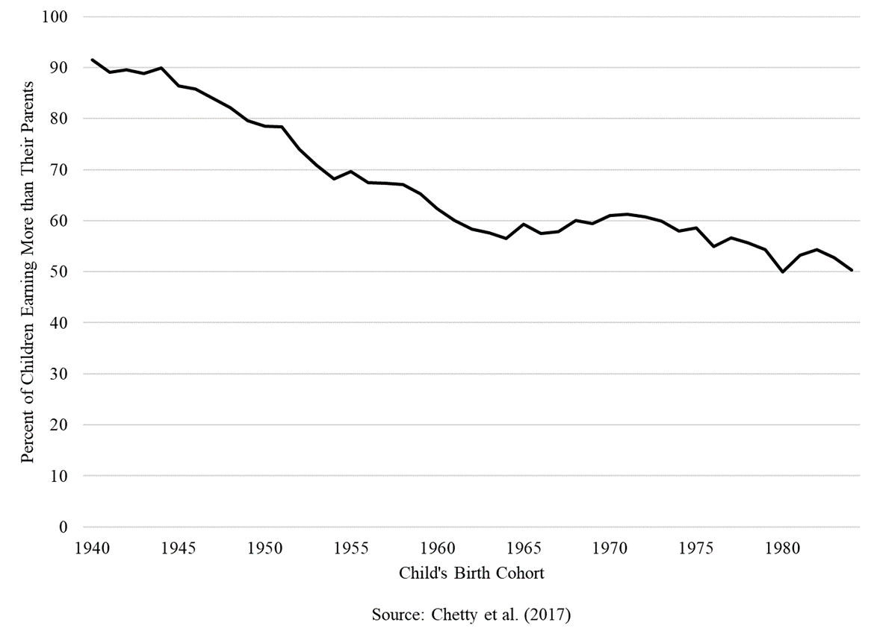
Will Future Generations Be Better Off Than We Are?
Notes:
Main reason for the decline is not the slowdown in economic growth, it is the widening distribution of income

Slide 13
For more information

